Slide 1
Big Mart Sales prediction
Mohammed Mutahar Shaik
# T00685545 IFSC 7370 Final Project Proposal Fall 2022

Slide 2
Introduction
This paper analyses the Big Mart Sales Prediction, in an effort to create an effective sales predictor that can be used for business decision-making purposes.

Slide 3
Problem Statement
The data scientists at BigMart have collected 2013 sales data for 1559 products across 10 stores in different cities. Also, certain attributes of each product and store have been defined.
The aim is to build a predictive model and find out the sales of each product at a particular store. Using this model, BigMart will try to understand the properties of products and stores which play a key role in increasing sales.

Slide 4
Data Description
The dataset contains a set of 8,523 records under 12 attributes
Item_Identifier : Unique product ID
Item_Weight : Weight of product
Item_Fat_Content : Whether the product is low fat or not
Item_Visibility : The % of total display area of all products in a store allocated to the particular product
Item_Type : The category to which the product belongs
Item_MRP : Maximum Retail Price (list price) of the product
Outlet_Identifier : Unique store ID
Outlet_Establishment_Year : The year in which store was established
Outlet_Size : The size of the store in terms of ground area covered
Outlet_Location_Type : The type of city in which the store is located
Outlet_Type : Whether the outlet is just a grocery store or some sort of supermarket
Item_Outlet_Sales : Sales of the product in the particular store.

Slide 5
Explore the problem in following stages:
Hypothesis Generation:
understanding the problem better by brainstorming possible factors that can impact the outcome
2. Data Exploration:
looking at categorical and continuous feature summaries and making inferences about the data.
3. Data Cleaning:
imputing missing values in the data and checking for outliers
4. Feature Engineering:
modifying existing variables and creating new ones for analysis
5. Model Building:
making predictive models on the data

Slide 6
Hypothesis Generation:
Since we’re talking about stores and products, lets make different sets for each.
Store Level Hypotheses:
City type: Stores located in urban or Tier 1 cities should have higher sales because of the higher income levels of people there.
Population Density: Stores located in densely populated areas should have higher sales because of more demand.
Store Capacity: Stores which are very big in size should have higher sales as they act like one-stop-shops and people would prefer getting everything from one place
Competitors: Stores having similar establishments nearby should have less sales because of more competition.
Marketing: Stores which have a good marketing division should have higher sales as it will be able to attract customers through the right offers and advertising.
Location: Stores located within popular marketplaces should have higher sales because of better access to customers.
Customer Behavior: Stores keeping the right set of products to meet the local needs of customers will have higher sales.
Ambiance: Stores which are well-maintained and managed by polite and humble people are expected to have higher footfall and thus higher sales.

Slide 7
Product Level Hypotheses:
Brand: Branded products should have higher sales because of higher trust in the customer.
Packaging: Products with good packaging can attract customers and sell more.
Utility: Daily use products should have a higher tendency to sell as compared to the specific use products.
Display Area: Products which are given bigger shelves in the store are likely to catch attention first and sell more.
Visibility in Store: The location of product in a store will impact sales. Ones which are right at entrance will catch the eye of customer first rather than the ones in back.
Advertising: Better advertising of products in the store will should higher sales in most cases.
Promotional Offers: Products accompanied with attractive offers and discounts will sell more.

Slide 8
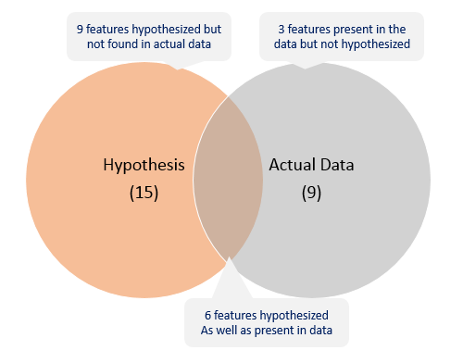
Data Exploration
Try to figure out some irregularities
looking at the data and try to identify the information which we hypothesized vs the available data.

Slide 9
Some observations:
Item_Visibility:
has a min value of zero. This makes no practical sense because when a product is being sold in a store, the visibility cannot be 0.
Outlet_Establishment_Years:
It vary from 1985 to 2009. The values might not be apt in this form. Rather, if we can convert them to how old the particular store is, it should have a better impact on sales.
The lower ‘count’ of Item_Weight and Item_Outlet_Sales confirms the findings from the missing value check.

Slide 10
Data Cleaning:
Since the outlet_size is a categorical column, we can impute the missing values by "Mode"(Most Repeated Value) from the column.
There are many ways data can end up with missing values.
For example:
The product wasn't weighed.
The data provider didn't include the outlet size of some products.
Most machine learning libraries (including scikit-learn) give an error if you try to build a model using data with missing values. we have for each column explore by:
1. numbers
2. %
This analysis will also compare to the test and train datasets for evaluation

Slide 11
Model Building
Broadly, my process was to run six different models: 1. Linear Regression 2. Random Forest Regressor 3. Lasso Regressor.
4. K Nearest Neighbors 5. Support Vector Classifier (SVC) 6. Gaussian Naive Bayes
Evaluation metrics:
Assumptions: This is a regression problem so we will use Regression methods.
Train test split will be a 8:2 ratio respectively.
Score Metrics for Regression:
1. Mean Absolute Error (MAE).
2. Mean Squared Error (MSE).
3. R-Squared(coefficient of determination)

Slide 12
Conclusion:
Finally to look Which model have the best performance.

